Slide 1
Improving Engagement with Indigenous Peoples
Lessons from Suriname
Aboriginal Program, PDAC - March 2018
Notes:
Nick Cotts, Vice President, External Relations & Social Responsibility

Slide 2
Outline
About Newmont
Indigenous Operating Context
Timeline
Case Study: Suriname
Lessons Learned

Slide 3
Who is Newmont?
Founded in 1921 (publicly traded since 1925)
Headquartered in Colorado
Approximately 24,000 employees and contractors worldwide
Included in Dow Jones Sustainability World Index for 11 years and named mining industry leader 3 years running
Recently included in Fortune magazine’s list of most admired companies
Newmont’s Purpose and Values
Our purpose is to create value and improve lives through sustainable and responsible mining.
Our values are safety, integrity, sustainability, inclusion and responsibility.

Slide 4
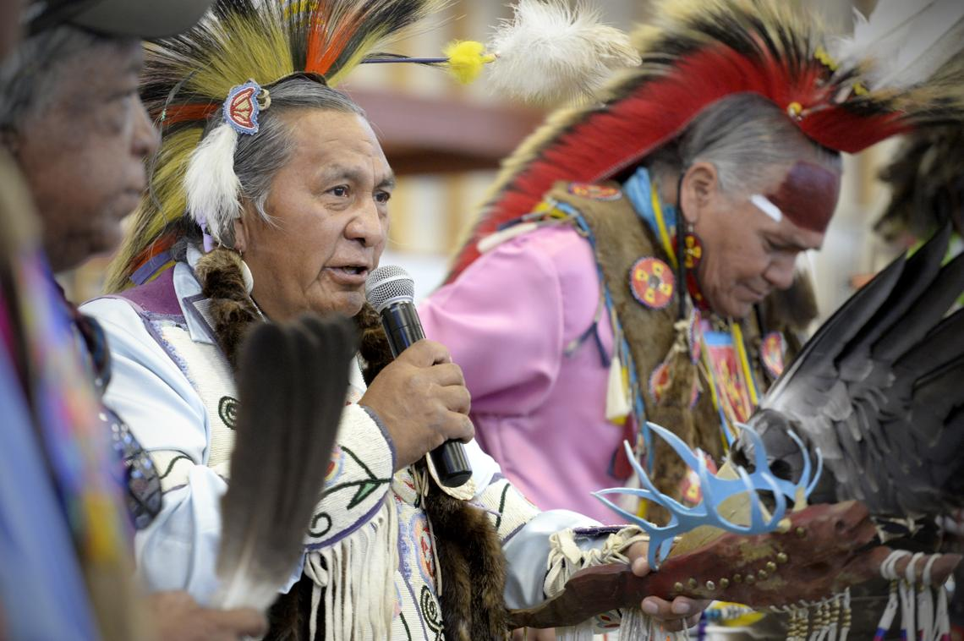
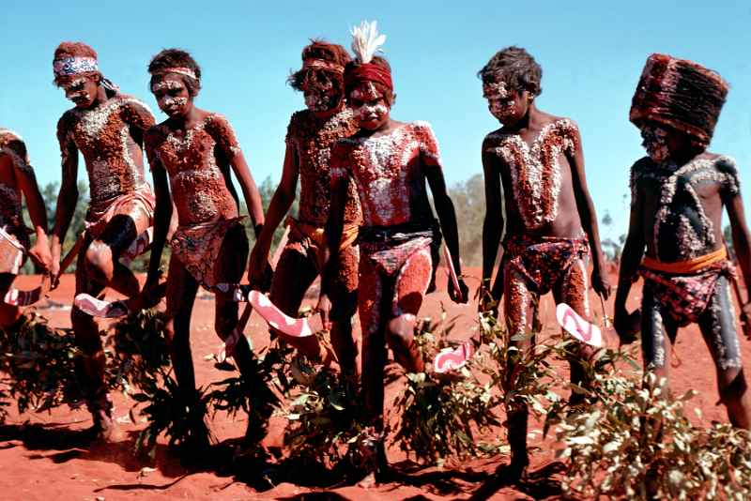
Intersection with Indigenous Peoples
Reserve sensitivity to gold price* (Moz)
North America
Carlin
Twin Creeks
Long Canyon
CC&V
Midnite Mine (L)
Spokane
Western Shoshone
Goshute
Africa
Ahafo
Akyem
South America
Yanacocha
Merian
Australia
Boddington
Kalgoorlie
Tanami
Woodcutters (L)
Pamaka Tribe
Kawina Tribe
Warlpiri
Gnaala Karla Booja
Ninga Mia

Slide 5
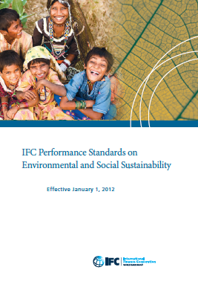
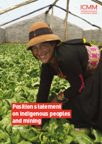
Indigenous Peoples Policy Timeline – milestones
2017:
Global Working Group
First set of standard audits
2015: Indigenous Peoples Standard
2014: Sustainability/ Stakeholder Engagement Policy includes IPs commitment
2008: ICMM Position Statement: Consultation and Engagement
2012: IFC Performance Standard updates include FPIC
2013: ICMM Position Statement: FPIC provision
2007: Universal Declaration on the Rights of Indigenous Peoples
2003: Social Responsibility Policy commitment to respect social, economic and cultural rights of indigenous people

Slide 6
Our Indigenous Peoples Standard
Culturally appropriate engagement
Culturally appropriate permission to enter lands
Impact evaluations in consultation with Indigenous Peoples
Newmont will work to obtain the Consent of Indigenous Peoples for new projects and changes to existing projects by focusing the process on reaching agreement on the basis for which the project should proceed
Formalize through agreements
Cross-cultural training
Local employment and procurement programs

Slide 7
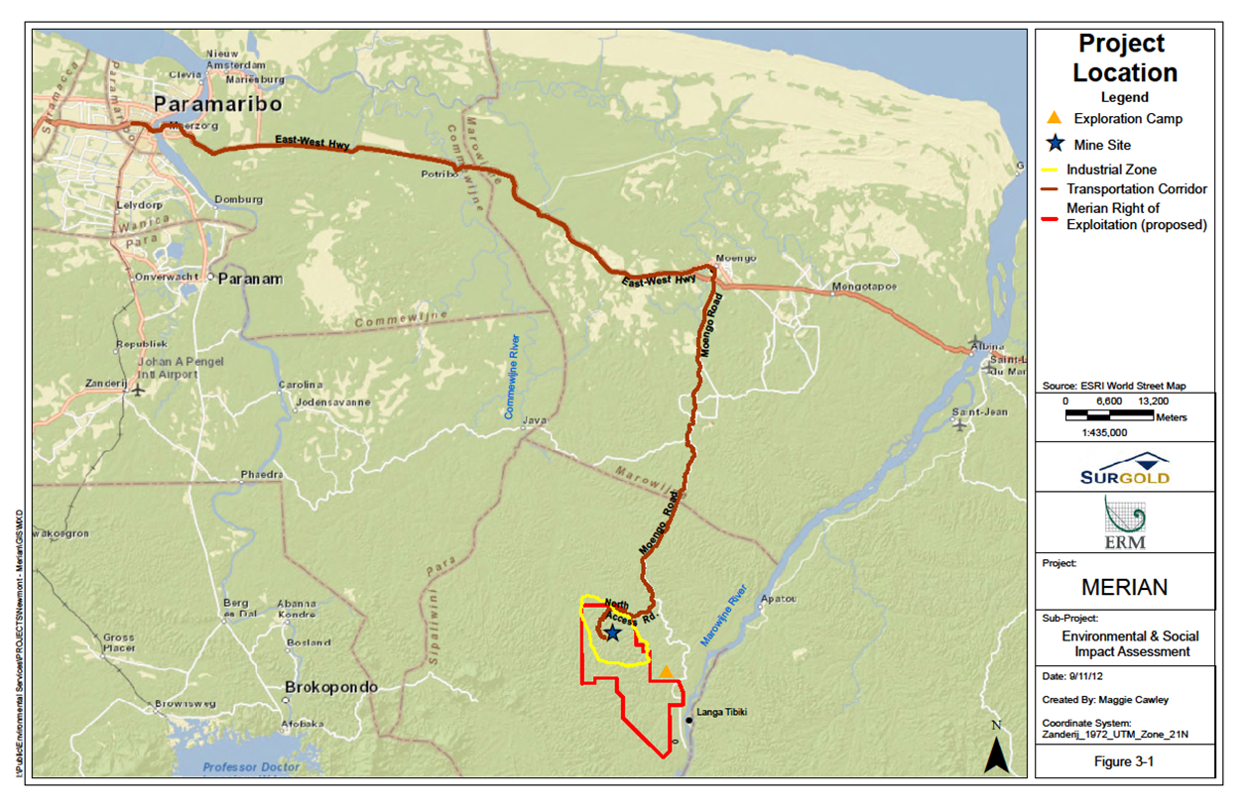
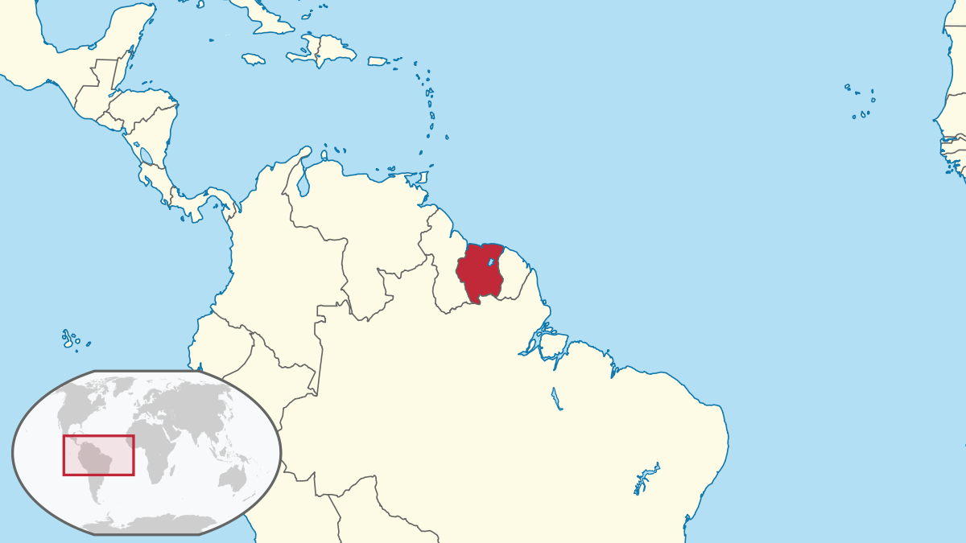
Case Study: Merian Mine - Suriname
Located on traditional lands of the Pamaka (Maroon Tribal People)
Pamaka, one of the country’s 6 Maroon Tribes, claim customary ownership of the land on which Merian is located
Newmont Suriname is a wholly-owned subsidiary of Newmont and is managing partner with Staatsolie (State-owned entity-25%)
No formal government recognition of customary land rights for any indigenous tribe (despite international rulings to do so)
Exploration underway since 2002

Slide 8
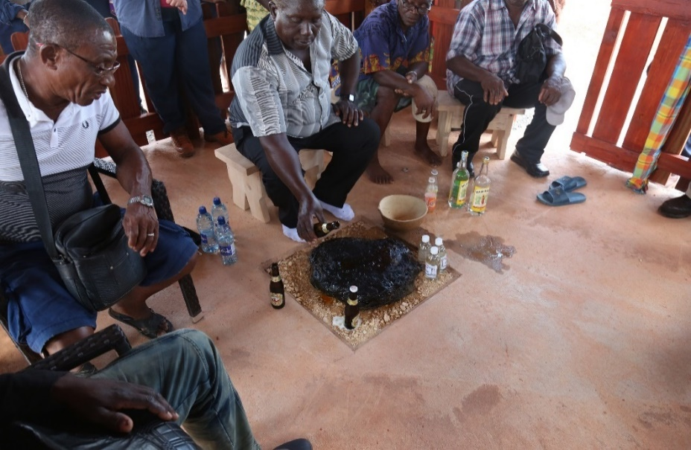
Our Approach
Commitment
Engagement
Expertise

Slide 9
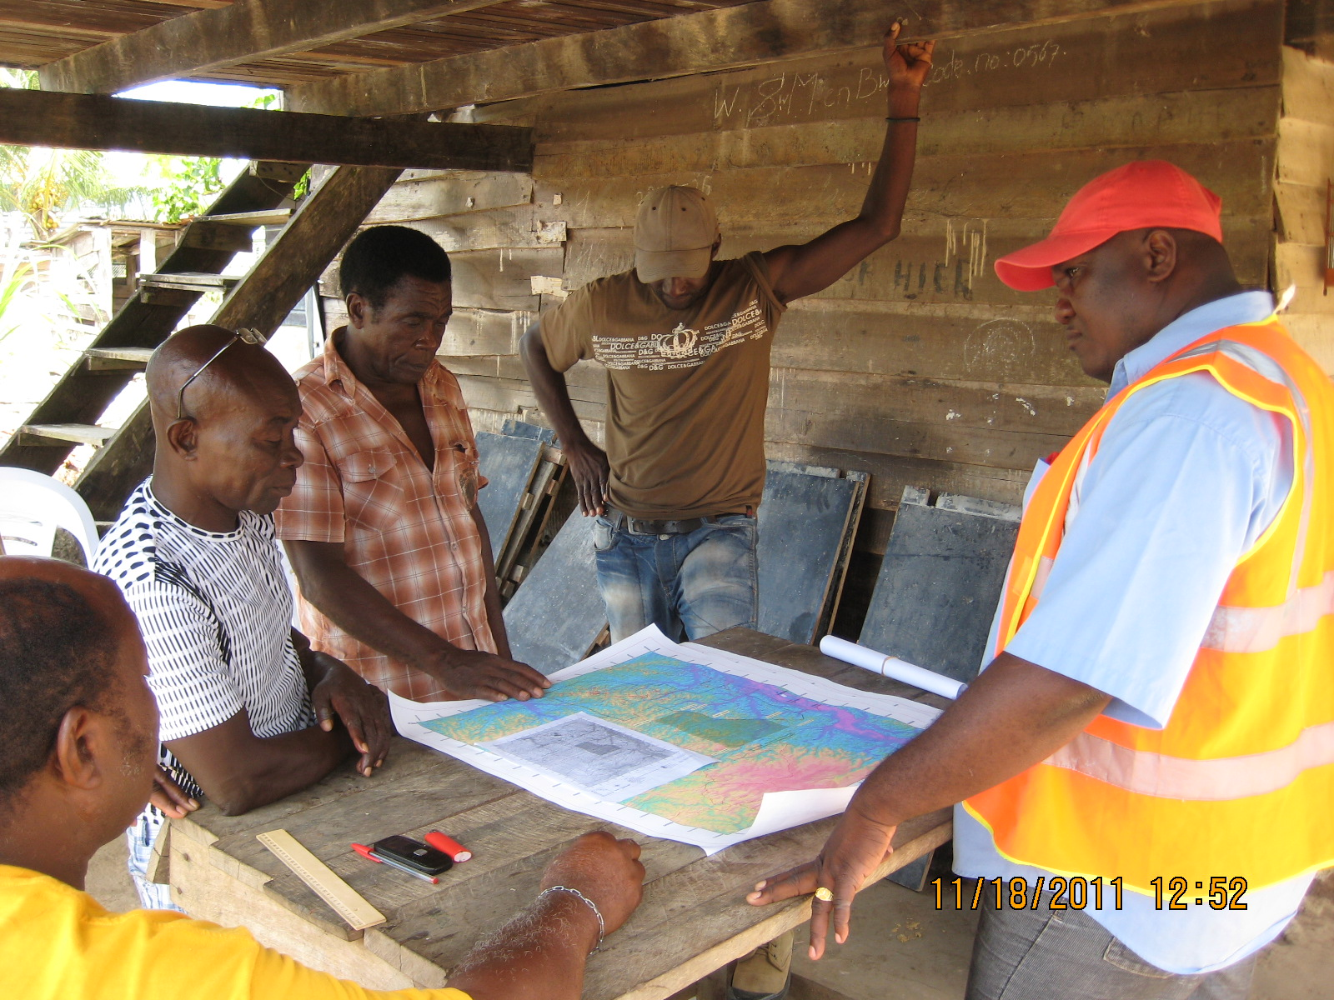
Engagement: working within traditional structures
Engage within traditional decision making structures
Village and household level engagement - prior to approval and construction
Requires multiple levels (Granman, Head Captains, Village Captains, Sub-chiefs, community)
Diverse channels:
Directly with Captains
Community radio
Field visits
Village assemblies “krutus”
Household meetings

Slide 10
Commitment: intent and agreement making
Letter of Intent: 2013
Engagement and relationship commitment
Commitment to agreement making and benefit sharing
Cooperation Agreement: Key Components
Local employment targets
Local procurement capacity
Participatory monitoring
Artisanal and Small-scale mining
Community Development Fund
Community Development Fund (2017)
Detailed in the Mineral Agreement negotiated with the government in 2013
Created after production commenced (August 2016)
Board membership consists of 6 reps, 2 each from Pamaka, Surinamese Government and Newmont Suriname)
Funding Agreement - $1/Oz Produced and Sold

Slide 11
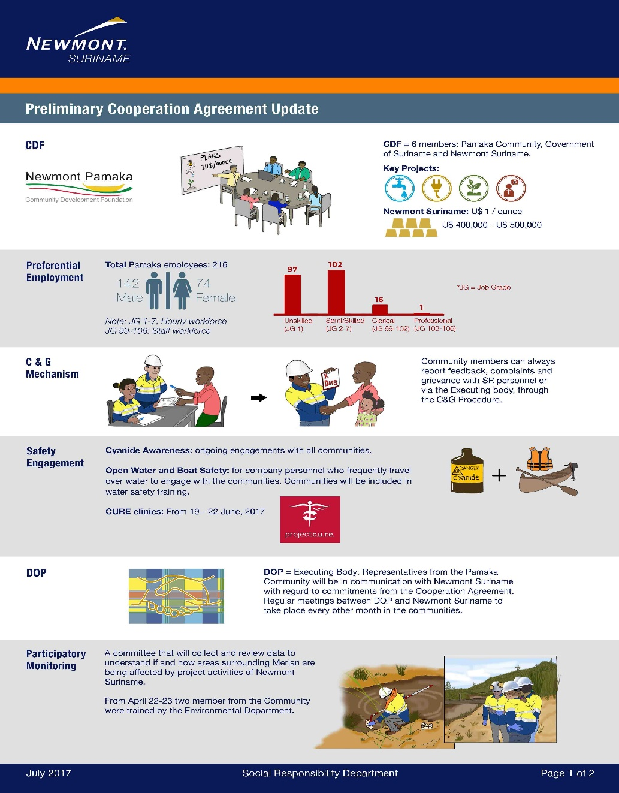

Slide 13
Expertise: we don’t have all the answers
RESOLVE FPIC Solutions Dialogue
Dialogue-based approach launched in 2012
NGOs, companies, Indigenous peoples thought-leaders
Engage in candid and open discussions about experiences and approaches to operationalize FPIC
Share real-world case studies
Identify lessons learned and successful approaches
Collaboratively explore how to navigate difficult scenarios

Slide 14
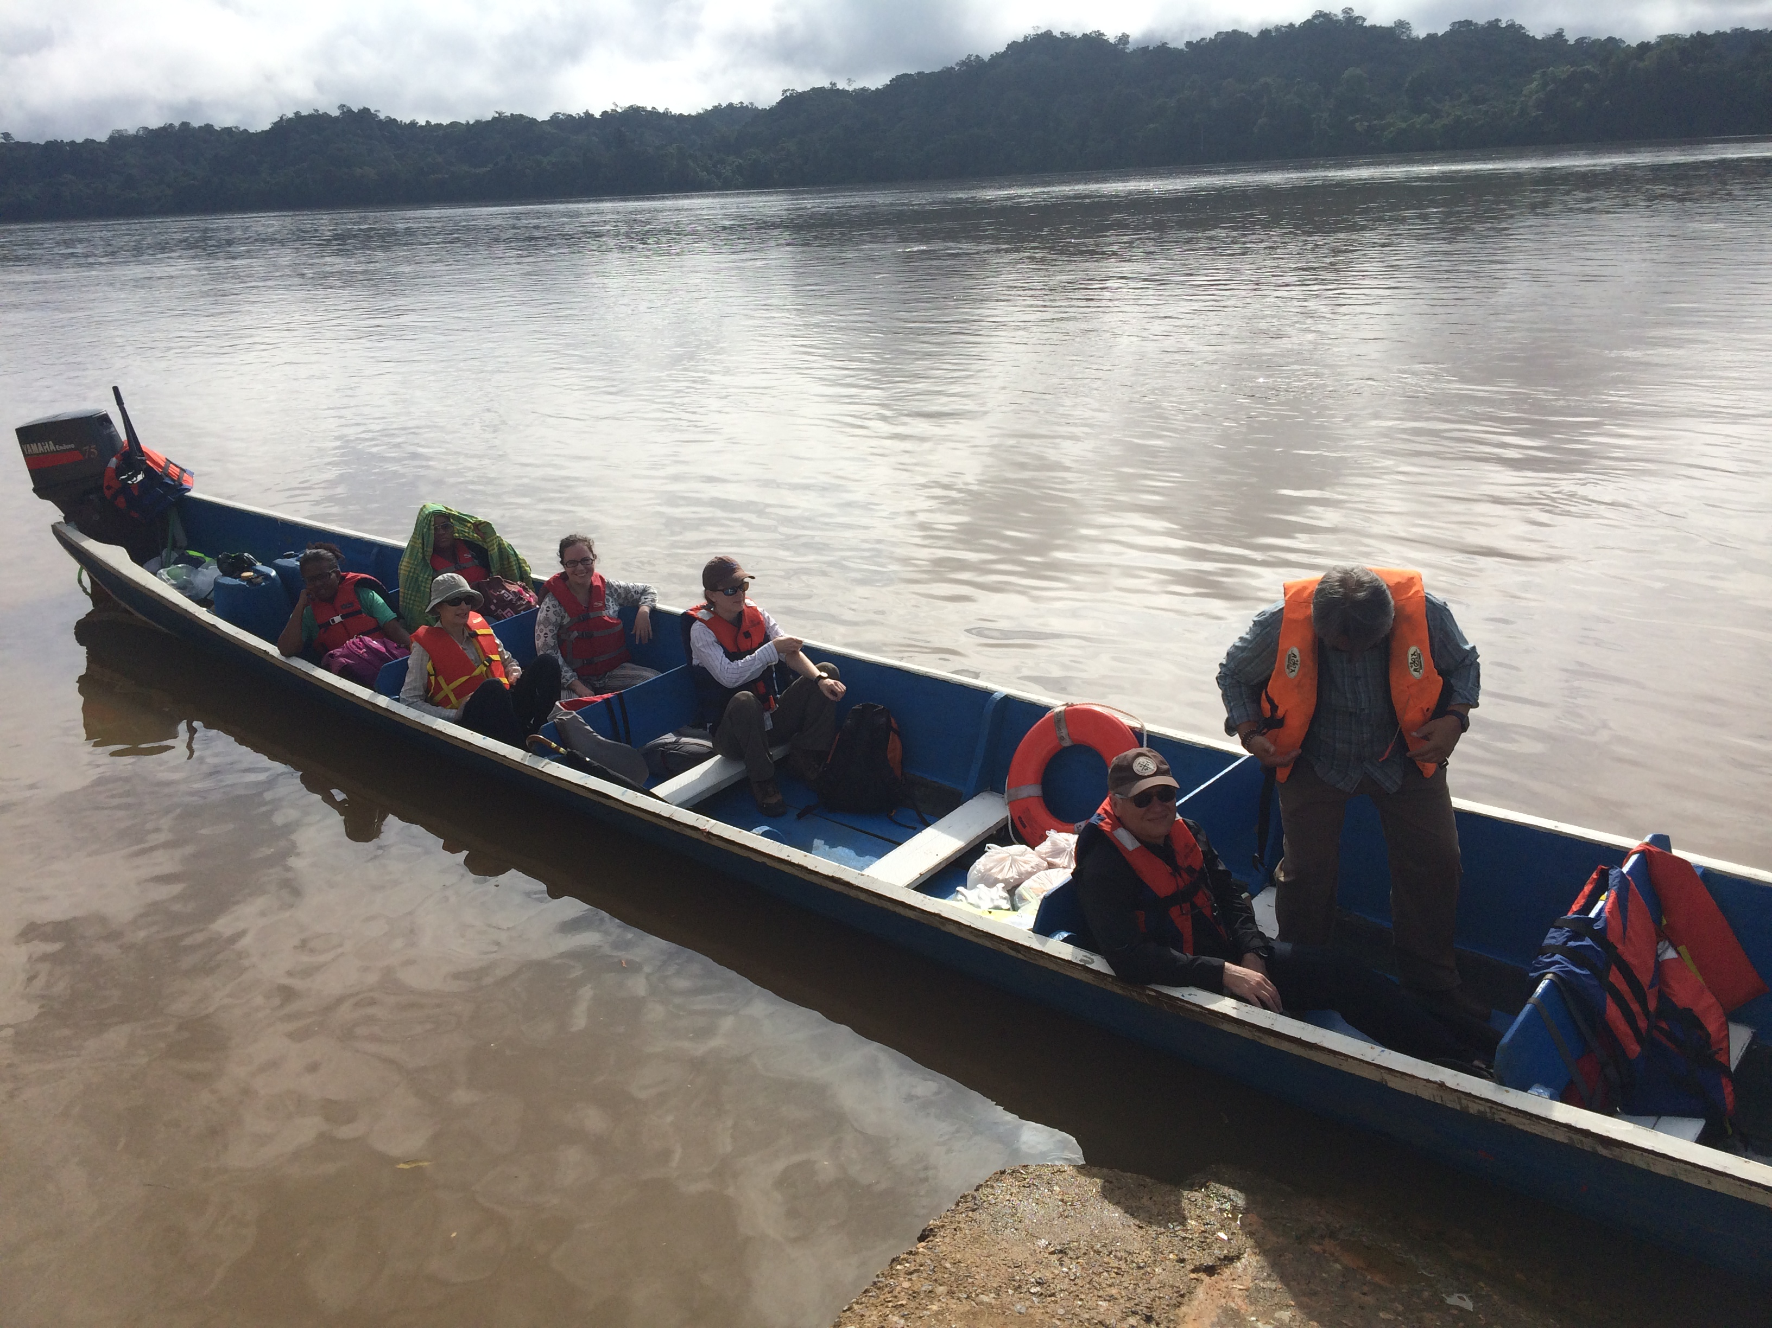
Suriname: Lessons-learned report
Internationally renowned experts
Advise Newmont on community engagement practices to operationalize FPIC within a human rights framework at Merian
Contribute to broader dialogue about lessons learned
Desk based reviews, discussions with key informants, two field visits

Slide 15
Expert Panel - Recommendations
Recommendation | Proposed Action
Negotiate with the Maroon Traditional Authority to structure agreements that recognize and reflect the customary land rights and land use on which Merian is operating | Review of current agreement to see what more is required to reflect land rights and benefit sharing
Work to encourage the Government of Suriname to recognize and secure the land and resource rights of the Maroon Tribes | Recent license acquisitions have seen an improvement in dialogue with rights-holders ahead of license award to seek consent-Newmont led this effort
Continue to engage with Maroon Traditional Authority structures, through mutually agreed mechanisms and processes | Working with the community stakeholder group and Traditional Authorities to be inclusive – women’s stakeholder group being established
Continue to support the Pamaka Traditional Authority and its’ delegate bodies with access to independent legal advice and other expertise | Established in the Cooperation agreements with the Traditional Authority and the representative body of Pamaka

Slide 16
Panel Recommendations and Actions
Recommendation | Proposed Action
Engage the Traditional Authority about how Newmont can improve its approach to community engagement, without undermining traditional structures | Recent effort is the re-establishment of community Radio Ajawde to become another channel of broader dissemination of info to the community
Ensure that company decision-makers have access to relevant information and resources to engage the Maroons in a manner that supports the principles of FPIC | FPIC Panel review report is part of that process
Ensure that social baseline and impact assessment studies are not for exclusive use by the company | The design of projects via the CDF will benefit from such data; we also have participatory monitoring with community and updating baseline studies
Ensure that Newmont personnel understand the relevance and significance of the company’s policy commitments | On-going

Slide 17
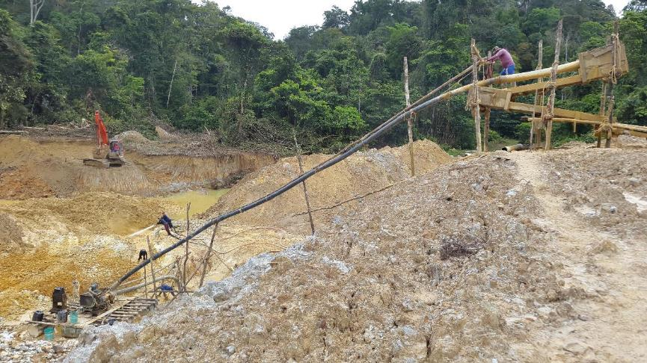
What we learned in Suriname
FIC process applied to established exploration project (not retrospective)
Informed consent without undermining traditional authority structures
Agreement making requires significant external/independent support
Social baseline adequacy for project and community - mutual interests
Government tolerated FPIC process - even if not in agreement
New exploration approach – slowing down for Government to play its role
FPIC is part of the exercise of “due diligence”

Slide 18
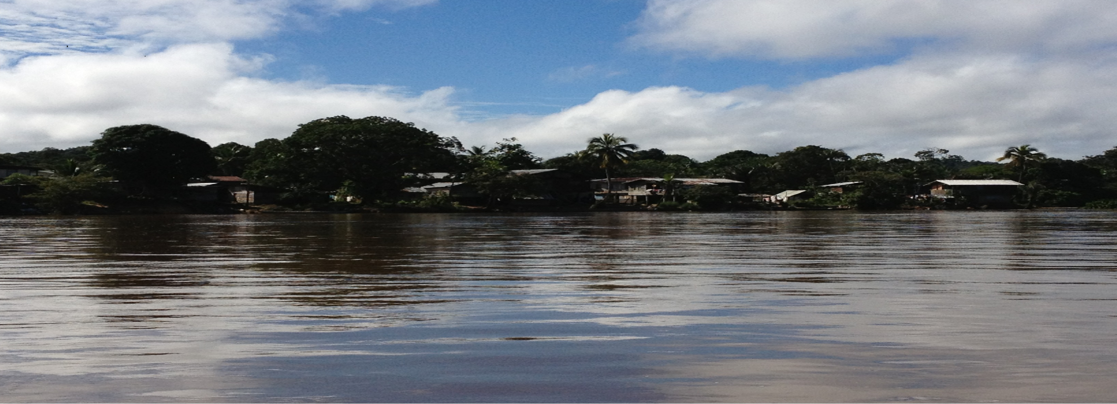
Challenges ahead
Negotiating based on land/resource rights – tension with legal systems
Revenue sharing vs. benefit sharing and who determines adequacy
Partnership-based resource development to promote wealth transfer
Traditional systems balanced with modern constructs – takes time
Remedying past practice - basis for future community Consent
Improvements are necessary-still work to do on our part

