Slide 1
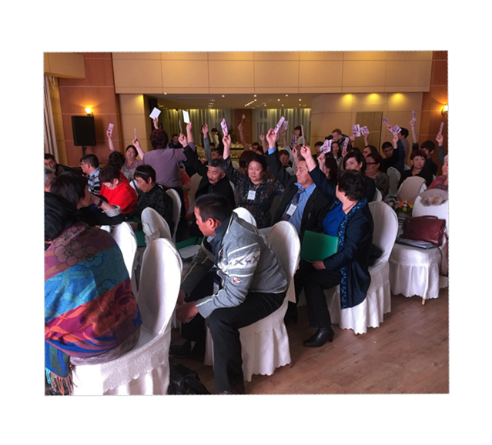
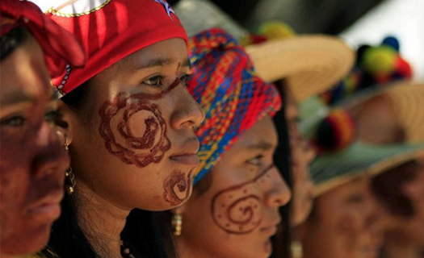
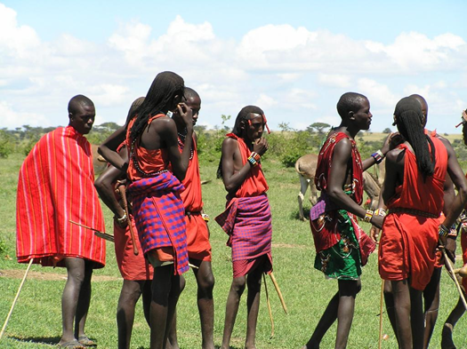
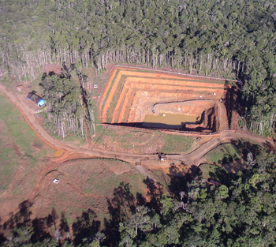
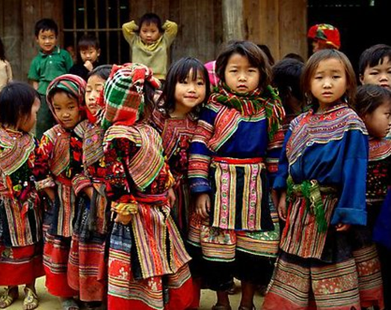
From Words to Actions: Implementing the Declaration on the Rights of Indigenous Peoples – The World Bank Experience
Luis Felipe Duchicela Global Adviser for Indigenous Peoples The World Bank
PDAC 2018 International Convention, Toronto, March 5, 2018
Notes:
1

Slide 2
Background on Indigenous Peoples
There are 370 million IPs in the world today, making up 5% of the population.
However, IPs represent 15% of the world’s extreme poor.
High levels of marginalization and inequality
Yet on the other hand:
IPs are stewards and custodians of 80% of the planet’s biodiversity
Untapped knowledge in all fields of human activity and in the natural environment

Slide 3
Indigenous Peoples and Mining
Often mining resources are located in ancestral territories of indigenous communities.
Historically, IPs have suffered forced evictions and relocations from their mineral-rich ancient lands due to state-sponsored development activities such as agribusiness, mining, and logging.
Mining projects may cause serious pollution due to the disposal of toxic substances.
The deprivation of Indigenous Peoples lands can lead to the destruction of their identity and existence as a people.

Slide 4
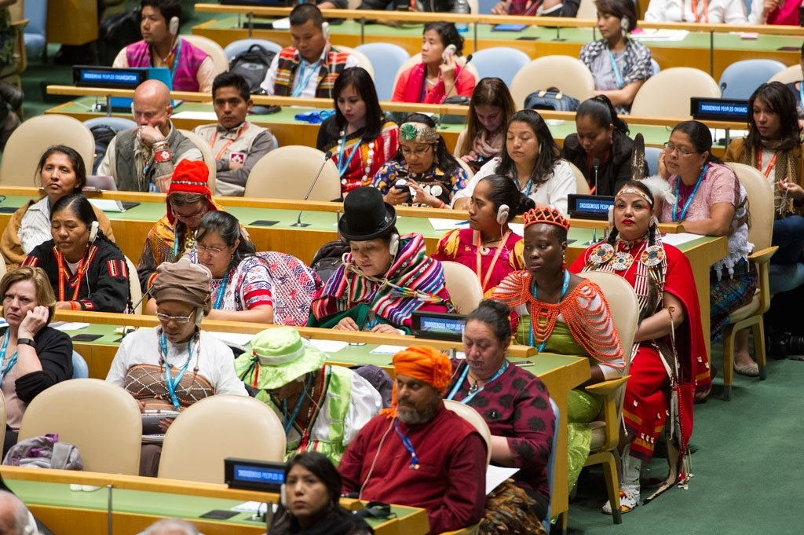
How is the World Bank Implementing UNDRIP?
World Bank Operational Policy 4.10 (OP 4.10) and Environmental and Social Standard 7 (ESS7) largely reflect the UN Declaration on the Rights of Indigenous Peoples (UNDRIP).

Slide 5
WBG Policies on IPs: Historical Overview
For 30 years, the Bank has recognized that IPs have distinct rights, with the following milestones:​
1982: OMS 2.34—Tribal People in Bank Financed Projects ​
First of its kind for an MDB. Required “a tribal component or parallel program” for “tribal people” adversely affected by Bank investments. ​
1991: OD 4.20—Indigenous Peoples​
Broadened the definition of the target group and to take account of ILO Convention 169. Benefits for IPs. ​
2005: OP/BP 4.10—Indigenous Peoples​
Updated in light of advances in the international recognition of the rights of IPs. ​
2012- 2016: Review and Update of the World Bank Safeguard Policies​
August 2016 – EDs approved the new Environmental and Social Framework

Slide 6
OP 4.10 Policy Objectives
Contribute to Bank mission of “poverty reduction and sustainable development”…by “ensuring that the development process fully respects the dignity, human rights, economies, and cultures of IPs” (para 1) ​
This objective is achieved through both (para 1): ​
A “do no harm rationale” i.e avoiding potentially adverse effects on IPs, and when avoidance is not feasible, to minimize, mitigate and compensate for such effects.​
A “do good rationale” i.e. ensuring that IPs receive social and economic benefits that are culturally appropriate and gender and intergenerationally inclusive.

Slide 7
When is OP 4.10 applied?
Application: The Policy applies to all projects proposed for Bank financing that “affect” IPs.
Criteria: Driven by the presence in or, collective attachment to the project area (land or related natural resources).​
Urban areas. The Policy also applies to groups in urban areas that meet the criteria (Para 4, and footnote 8). ​
Impact: Project impact (potential or actual; positive or adverse) does not influence applicability of the Policy. ​
No de minimis rule. Even a small number of IP triggers the Policy​
All components. The Policy applies to all components of the project, regardless of the source of financing (footnote 3).

Slide 8
Global Dialogue on Environmental and Social Policies
Objectives:
Improve the effectiveness and efficiency of the World Bank environmental and social safeguard policies
Strategies to address broader development issues of Indigenous Peoples
Enhance the engagement process with Indigenous Peoples
Regional Dialogues:
In a three-phase process, dialogues were held in all Bank regions.
High-level Meetings:
Meetings in Washington, DC, April 13-15, 2015 where 30 Indigenous Peoples leaders met with the World Bank President, Executive Directors and senior management.

Slide 9
IPs’ recommendations for the Safeguards Review
Several recommendations emerged from the Global Dialogue and were reflected in the second draft of the Environmental and Social Framework (ESF), mainly:
Free, Prior and Informed Consent (FPIC) included
The Draft ESF informed by and aligned with the UN Declaration on the Rights of Indigenous Peoples (UNDRIP)
Definition of Indigenous Peoples broadened to include pastoralists
“Alternative approach” removed from the second ESF draft

Slide 10
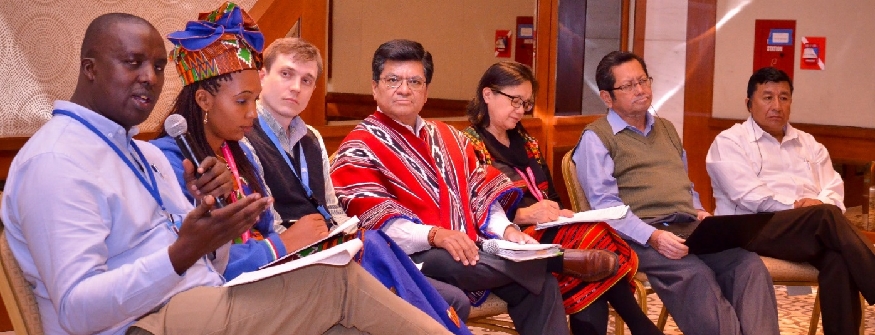
Indigenous Peoples Technical Advisory Group
One recommendation from the Global Dialogue on ESF.
The general objective is to provide guidance and expert advice to the World Bank’s management on specific operations.
Terms of Reference: developed by task force, discussed in regional dialogues in Asia, Africa, Latin America and Russia, Global Dialogue during UNPFII, internal clearance
IP-TAG nomination process began.

Slide 11
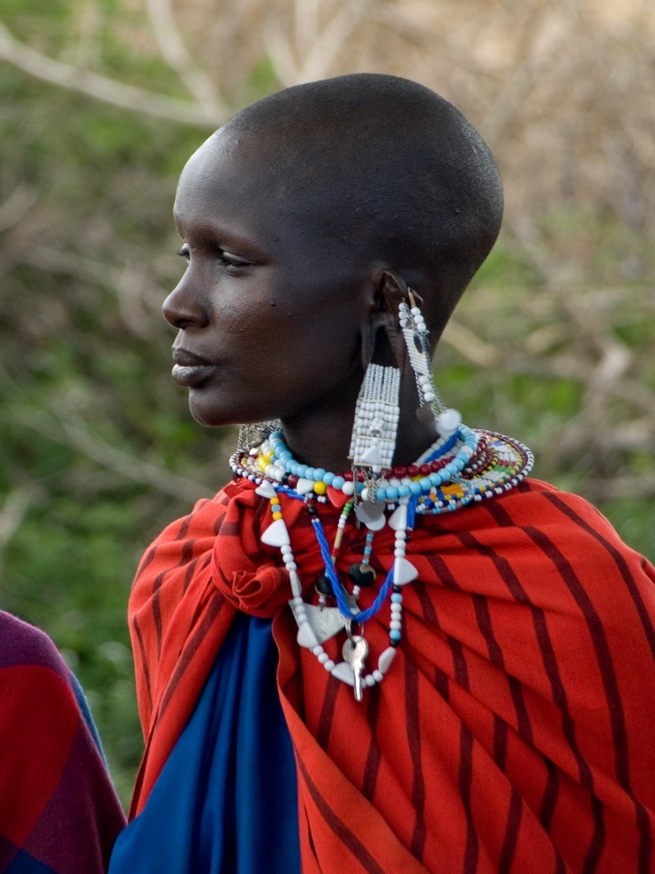
Environmental and Social Standard 7
Maintains from OP 4.10: Ensures that the development process fosters full respect for the human rights, dignity, and cultures of Indigenous Peoples.
Main differences from OP 4.10:
ESS7 includes:
Pastoralists
IPs in voluntary isolation
Free Prior and Informed Consent for projects in three situations
Broader application of IP standards to enhance the inclusion of IPs in different development opportunities
Application of ESS7 will be done as part of an integrated approach

Slide 12
Key Points: The Concept of “Meaningful Consultation”
“Meaningful consultation tailored to Indigenous Peoples” applies across the board. The purpose is to build community support. It is the social license to proceed with the project. It is distinct from the requirement to obtain FPIC in the three circumstances.

Slide 13
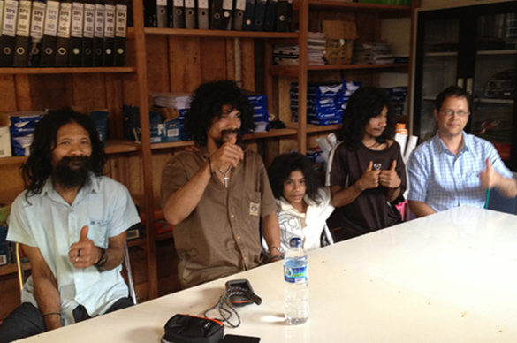
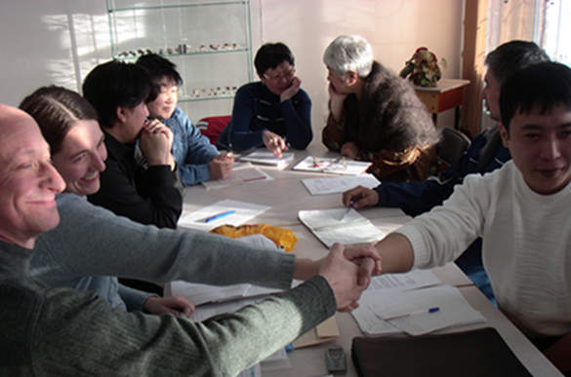
UN Declaration on the Rights of Indigenous Peoples
Free Prior and Informed Consent - Article 19
States shall consult and cooperate in good faith with the indigenous peoples concerned through their own representative institutions in order to obtain their free, prior and informed consent before adopting and implementing legislative or administrative measures that may affect them

Slide 14
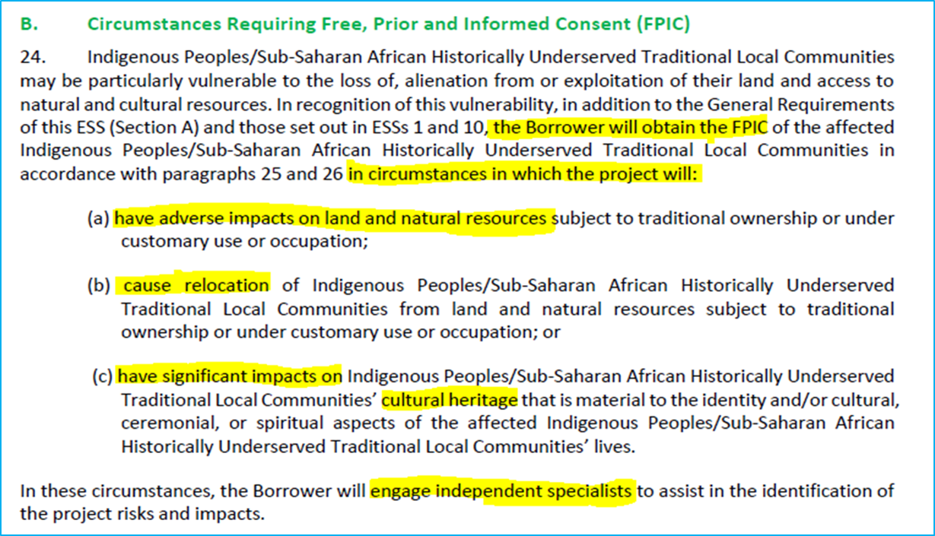
Key Points: The Concept of FPIC
Was introduced in the first draft and maintained. Its meaning in the context of ESS7 and key elements have been elaborated.

Slide 15
Beyond OP 4.10 and ESS7
OP 4.10 and ESS7 are a good proxy for a human rights based approach, however, they are more technical than UNDRIP as they are designed for use by World Bank Staff and may not reflect material as comprehensive as UNDRIP does.
Therefore, to complement OP 4.10 and ESS7:
Knowledge Platform - Provide easy access to best practices, case studies and methodologies and experts for World Bank task team leaders to implement a HRBA specific to IPs and EMs in development projects.
Conceptual Results Framework and Indicators for IP Rights - link UNDRIP with OP 4.10 and ESS7 to identify indicators that measure the impact of World Bank projects on IP rights.

Slide 16
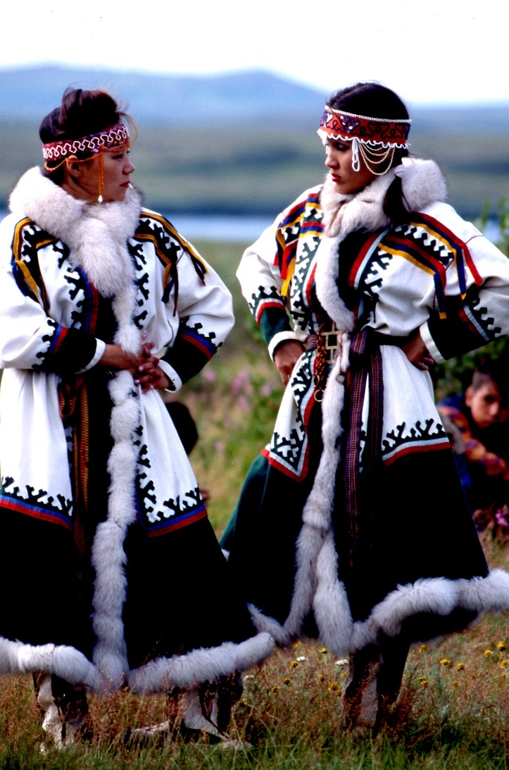
Nordic Trust Fund Grant
Mainstreaming and Scaling Up a Human Rights Based Approach for Indigenous Peoples and Ethnic Minorities Development in World Bank Projects
A HRBA means “All programs of development co-operation, policies and technical assistance should further the realization of human rights as laid down in the UDHR and other international human rights instruments.” (UN HRBA Portal)

Slide 17
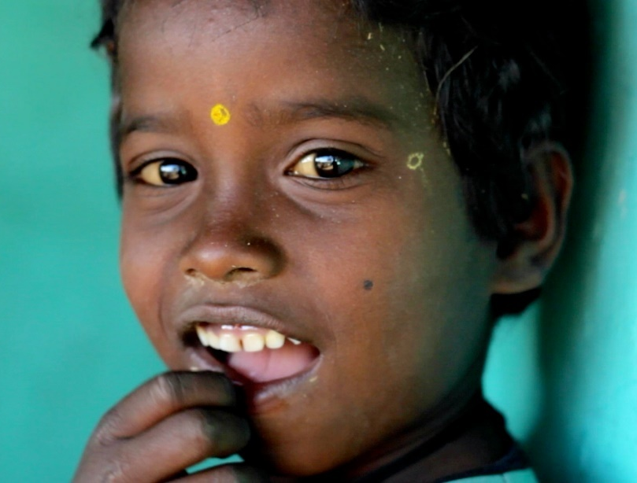
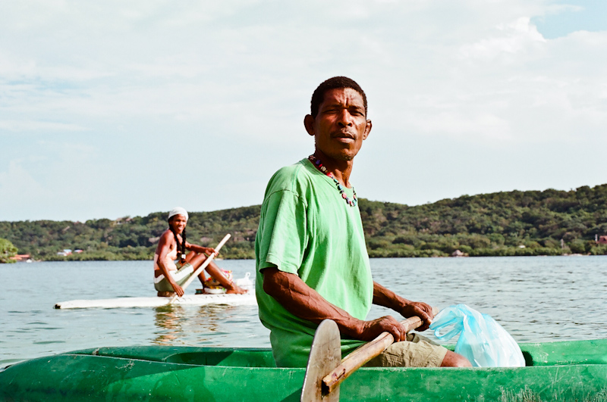
NTF Grant Implementation
Identified eight projects (five are NTF funded) with IPs and EMs to give advice and guidance to implement a HRBA
Established IP Rights Expert Group (IPREG) with members from OHCHR, ILO, EMRIP, NTF, WB, who will connect with project teams
IP-Technical Advisory Group will ensure project teams take into account voice of IPs/EMs
Knowledge Platform and Results Framework

Slide 19
Global Mining Sector NTF Grant
Human rights-based approach to address the causes of environmental conflicts in the mining sector
Objective:
(i) identify, from a human rights perspective, the causes and escalating factors of socioenvironmental conflict associated with mining projects;
(ii) identify international practices to protect and promote human rights in the context of mining development; and,
(iii) propose policy and investment options to support country clients to address socioenvironmental conflicts by protecting and promoting human rights that can be further converted into components of Bank-financed operations.
Adding IP dimension to project

Slide 20
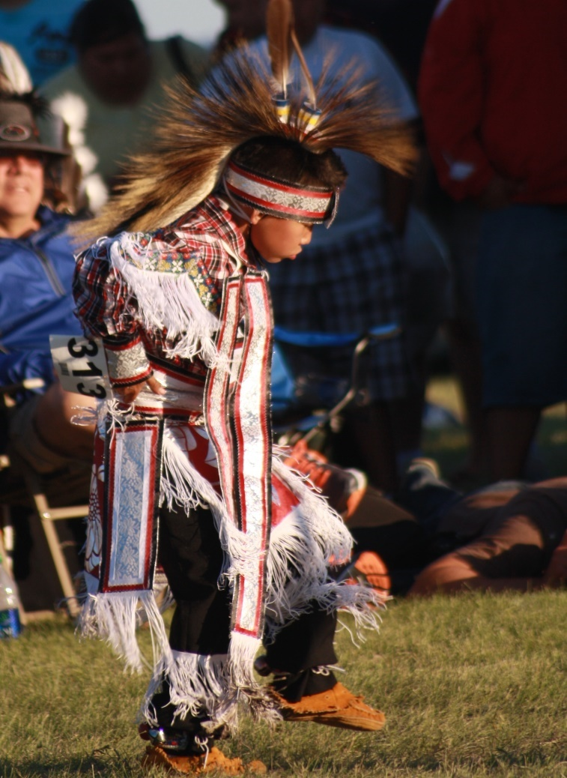
Conclusions and Vision for the Future
Importance of understanding and recognition of collective rights
Issue of recognizing and respecting governance of IPs
Issue of benefit sharing and how this should be oriented for sustainable development of the First Nations
FPIC is not a silver bullet and should be considered as one instrument, part of a more holistic approach, oriented towards self-determination.
The only valid approach to development for Indigenous Peoples is the holistic, integrated approach.

Slide 21
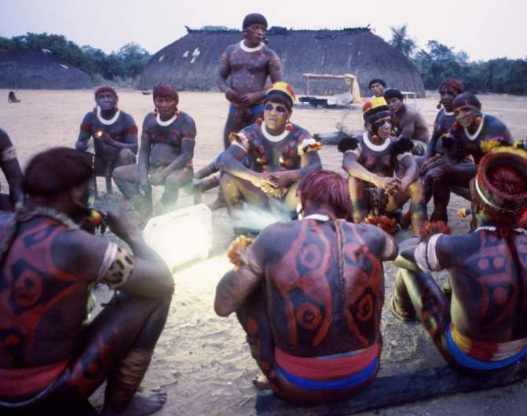
Conclusions and Vision for the Future
The fundamental responsibility for IP rights, empowerment and inclusion resides with governments.
IP leadership plays a key role in achieving the above goals, and therefore, capacity building of IP leaders and organizations is vital for the future.
One of the biggest challenges that IPs and states face is the understanding and use of traditional knowledge.

Slide 22
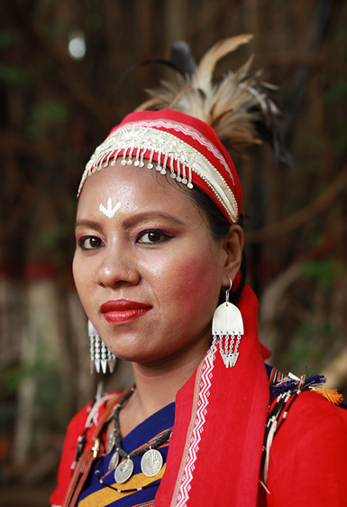
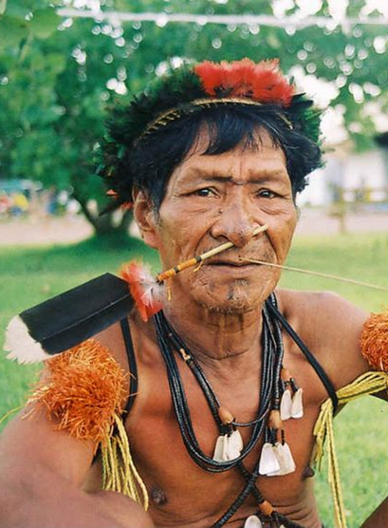
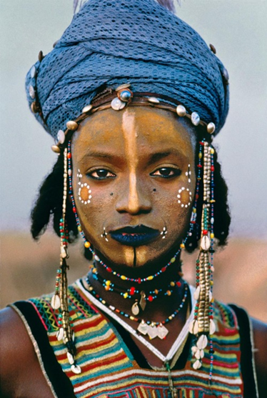
Thank You!
Luis Felipe Duchicela, Global Adviser for Indigenous Peoples,
The World Bank
lfduchicela@worldbank.org

