Slide 1

Driving Impactful Change -
Economic Reconciliation
Toronto, PDAC 2018
JP Gladu, President and CEO
@jp_gladu

Slide 2
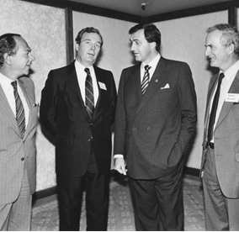
CCAB
Created over 35 years ago by Murray Koffler
National member based organization
Non-partisan – Receives no core government funding
Approaching 600 Members
Key programs – PAR, CAB, ABMP, TFAB Research, and Awards & Events
MISSION
To foster sustainable business relations between First Nations, Inuit and Metis businesses and Canadian Business
Notes:
2

Slide 3
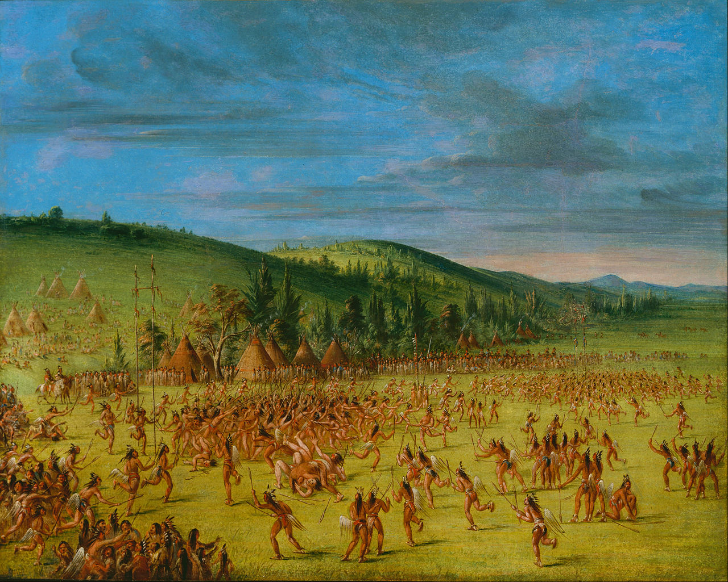

Slide 4
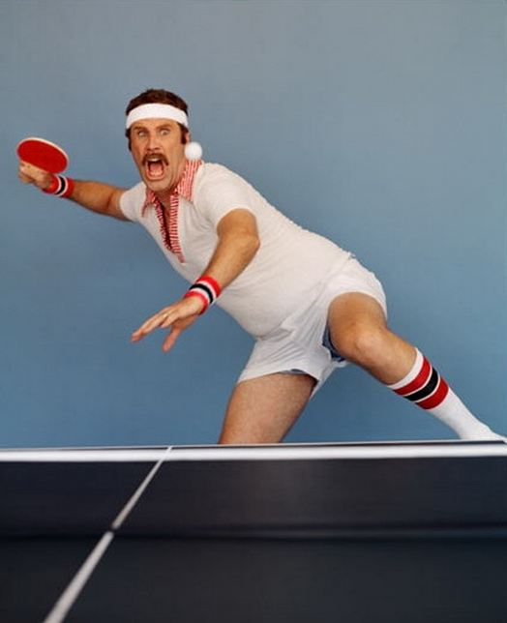

Slide 5
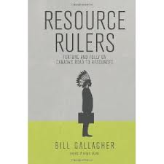
Driving Factors
Resource Sector Based Communities
Supreme Court Decisions
Corporate Canada, making the turn

Slide 6
Shared Values
Aboriginal (seeking) | Corporate (seeking)
Revenue | Revenue
Employment | Human Resources
Security | Security
Relationships and Contracts * Partnerships & JV’s | Business Support Services * Aboriginal Businesses
Environment and Culture | EA and CSR Approval
Certainty | Certainty

Slide 7
Estimating the size of the Aboriginal Market in Canada - 2016
TD Economics
Total combined income of Aboriginal households, businesses and government sectors could reach $32 billion.
Resource sector contributed significantly in last decade.

Slide 8

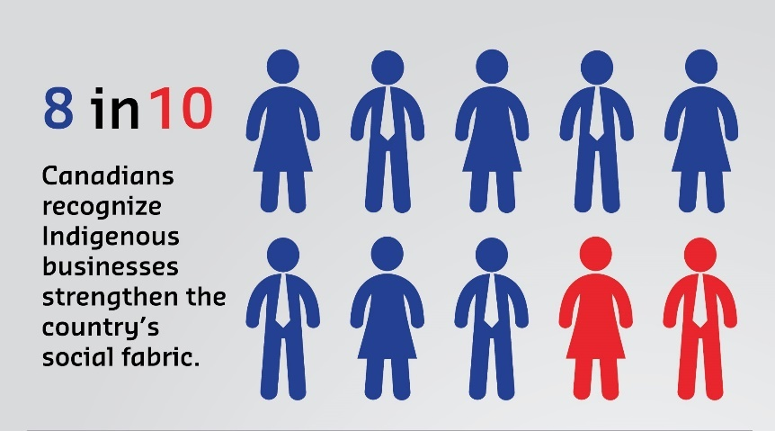
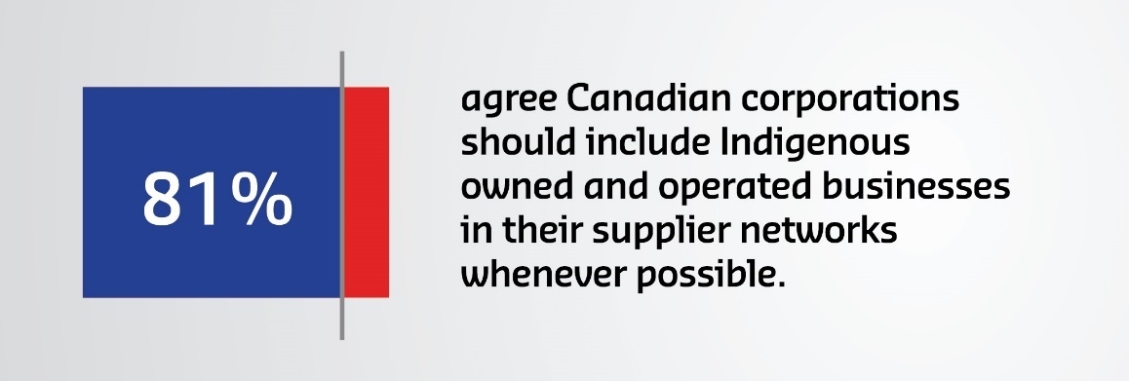
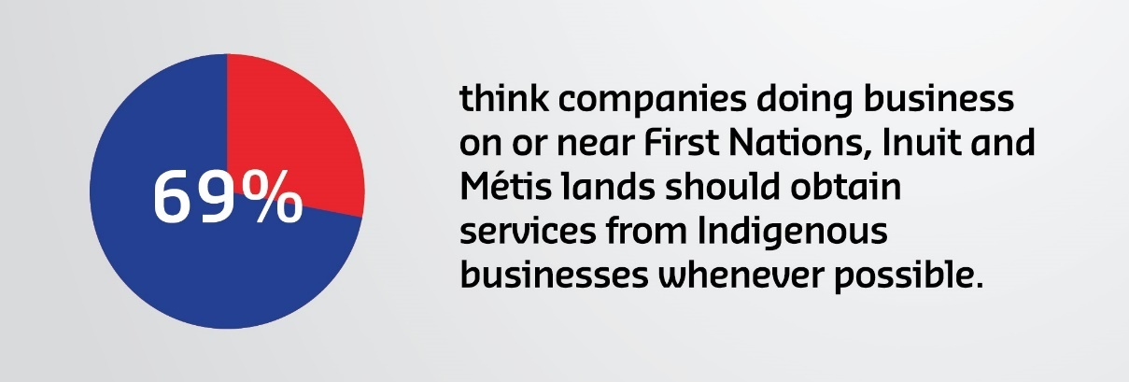


Slide 9
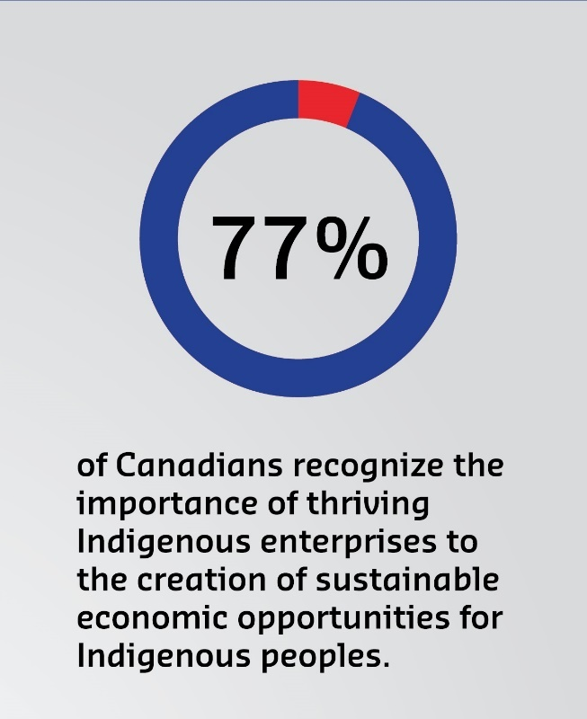
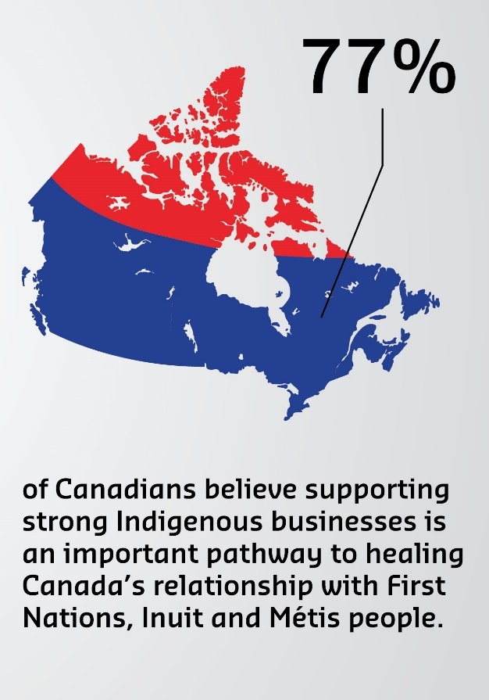
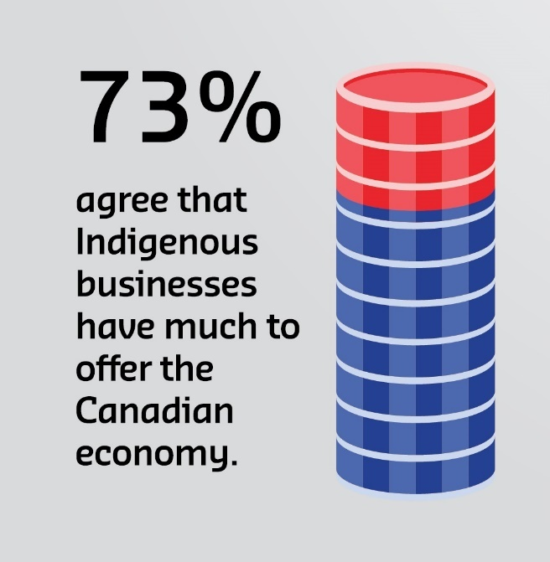

Slide 10


Government Procurement
$224B
$20B
AVERAGE PROCUREMENT STRATEGY FOR ABORIGINAL BUSINESS (PSAB) SPEND PER ANNUM
$63M
*1.1B in spend since 1996
Total Government Procurement in Canada (2016) *
Total Federal Government Procurement
(2015)
*all levels of procurement (Fed/Prov/Terr/Muni) as determined by 12% of GDP (according to the Organization for Economic Co-operation and Development)
https://www.canada.ca/en/treasury-board-secretariat/corporate/reports/contracting-data/2015-purchasing-activity-report.html
TOTAL PSAB AS % OF GOVERNMENT PROCUREMENT
0.32%
Notes:
Total Government Procurement in Canada (2016) $224B
*all levels of procurement (Fed/Prov/Terr/Muni) as determined by 12% of GDP (according to the OECD)
Total Federal Government Procurement (2015) $20B
*https://www.canada.ca/en/treasury-board-secretariat/corporate/reports/contracting-data/2015-purchasing-activity-report.html
Average PSAB Spend Per Annum (website) $63M
*from the website - $1.1B in spend since 1996 – I assumed $1.1B over 17 years
Total PSAB as % of Fed Govt Procurement 0.32%
PSAB should be tracking and reporting the annual spend by amount and department.

Slide 11
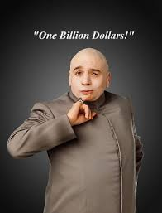




Private Sector Procurement

Slide 12


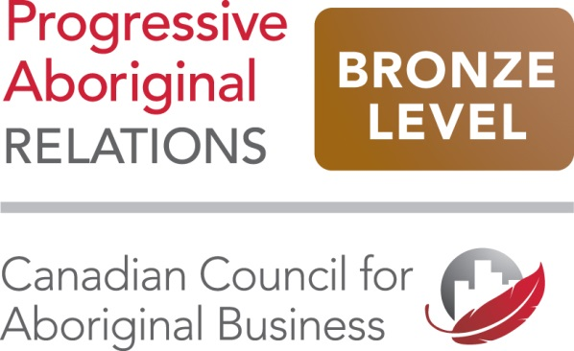

PAR
Notes:
12

Slide 13


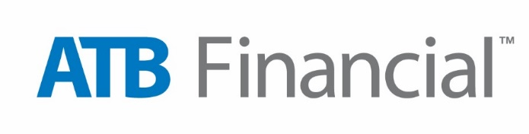





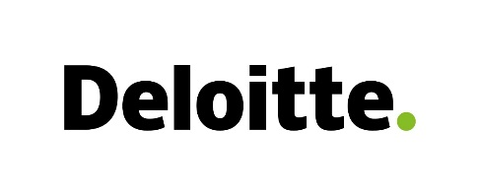




Notes:
13

Slide 14









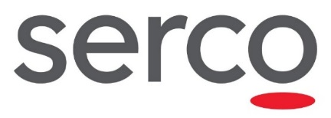




Slide 15
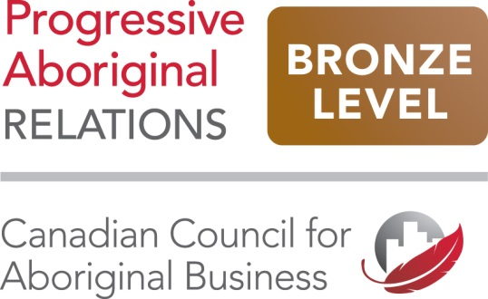
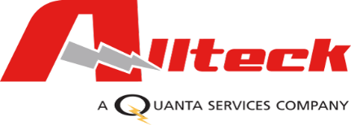












Slide 16








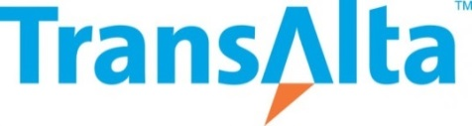
Notes:
16

Slide 17












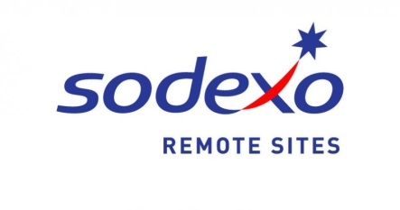


Notes:
17

Slide 18
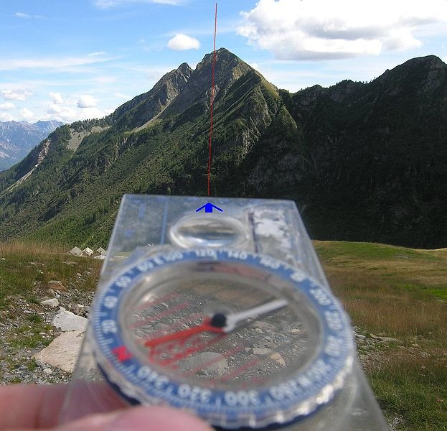
Parting thoughts…
The opportunity lies
in our ability to acknowledge our shared HISTORY, align our STRENGTHS, and remain open to CHANGE.

