Slide 1

PEOPLES OF THE SACRED WATERFALLS AND TSANTSA
Rubén Naichap Yankur President of the Zamora Chinchipe Shuar Federation
ZAMORA CHINCHIPE SHUAR FEDERATION

Slide 2
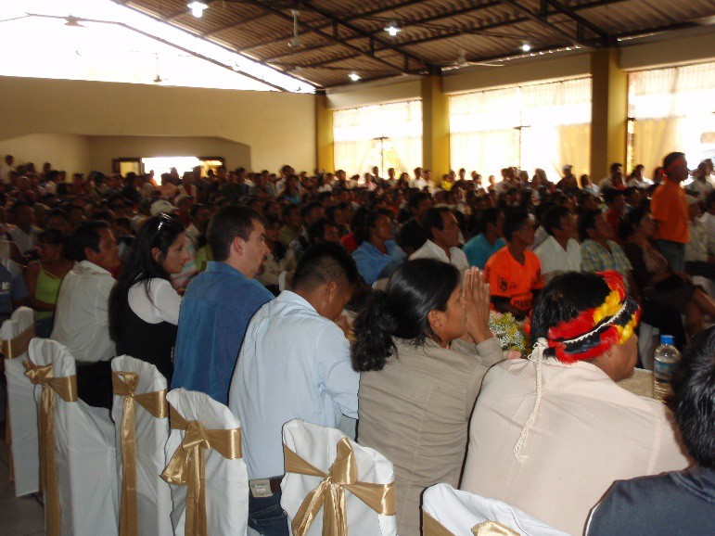
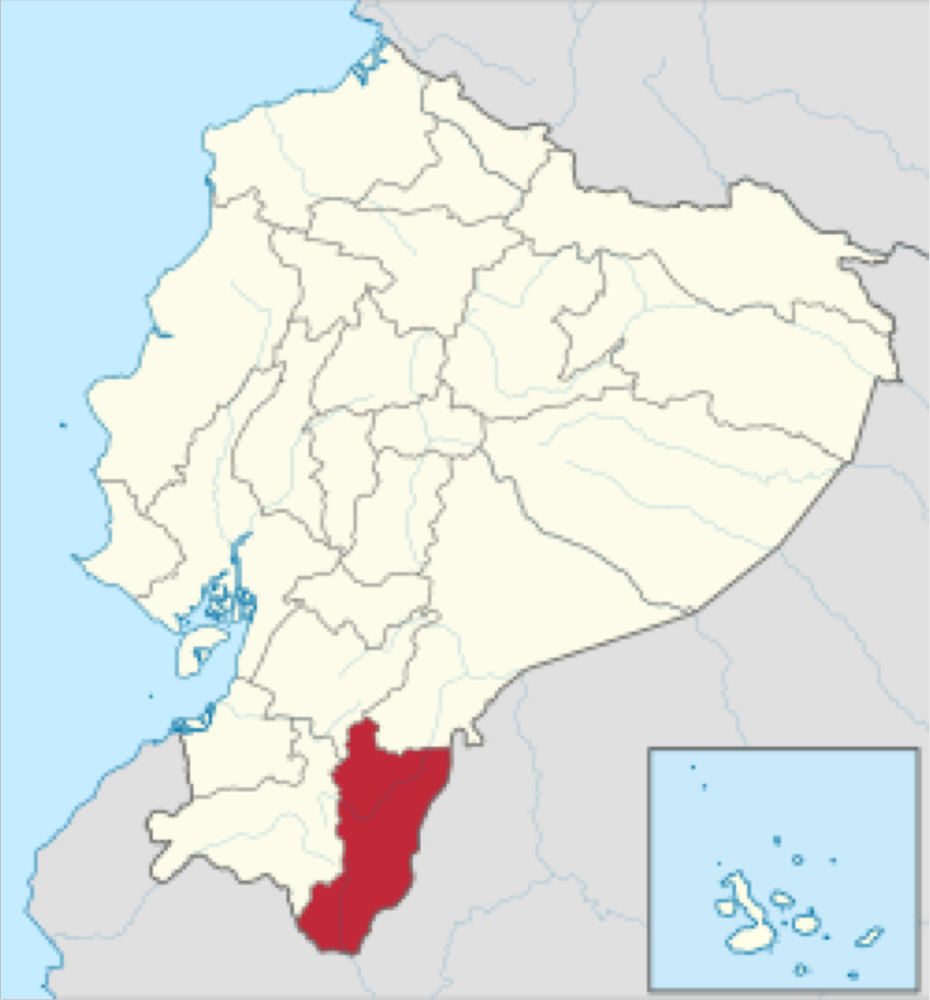
WHERE WE ARE LOCATED?
VISION
Be a productive and technical organization.
Conserve cultural identity.
Foster community participation.
Foster economic development based on the use of our natural, renewable and non- renewable resources.
72 Communities
7 Associations
12,000 people
642 km² of territory
ZAMORA CHINCHIPE SHUAR FEDERATION

Slide 3
VISION OF MINING
Institutional strengthening.
Conserve culture and beliefs while protecting natural resources.
Develop human capital through training programs and scholarships.
Implement infrastructure and quality social services through partnerships with communities, local governments and private companies.
Create sustainable business ventures in tourism, organic coffee and cocoa production, applying fair trade systems.
We hope that the company will act responsibly with natural resources, particularly in relation to water access and quality.
We believe in Corporate Social Responsibility and ethical conduct.
Properly developed mining constitutes an opportunity for both the country and the Shuar people.
We want mining to go hand in hand with the human development of our communities.
We strive to use dialogue to build opportunities and overcome challenges.
STRATEGIC PLAN
ZAMORA CHINCHIPE SHUAR FEDERATION

Slide 4
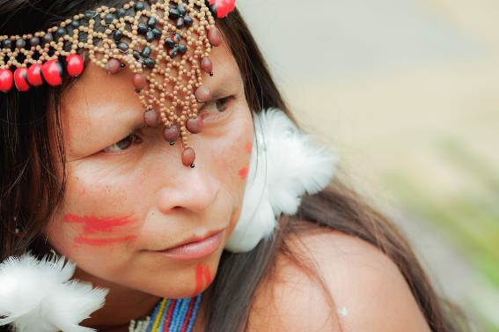
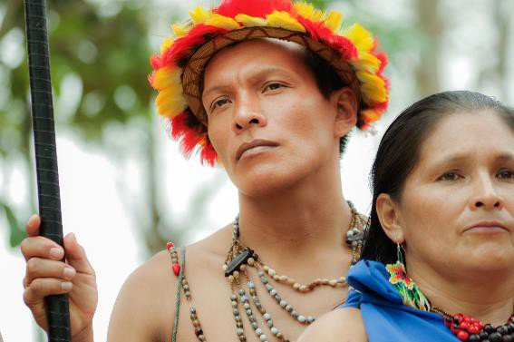
CONTEXT FOR DIALOGUE WITH LUNDIN GOLD
The peoples concerned shall have the right to decide their own priorities for the process of development as it affects their lives, beliefs, institutions and spiritual well-being and the lands they occupy or otherwise use, and to exercise control, to the extent possible, over their own economic, social and cultural development. ILO Convention no. 169, Article 7
CORNERSTONES OF WORK WITH LUNDIN GOLD
Protecting and valuing customs and traditions.
Institutional strengthening.
Creation of a service company.
Productive development.
Capacity building.
Zamora Chinchipe Shuar Federation

Slide 5

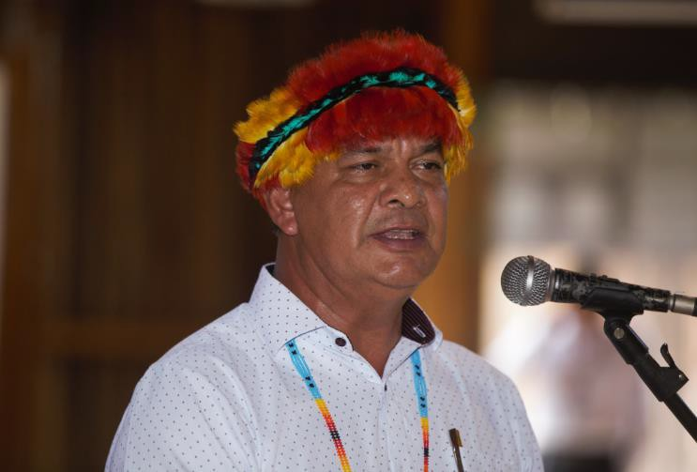
Makete
Thank you very much
Rubén Naichap Yankur
Republic of Ecuador
Shuar Nation
Cell phone: +593 98 695 8688, Ecuador Email: Ruben.naichap@yahoo.es
Skype: ruben.naichap1
Zamora Chinchipe Shuar Federation

Slide 6
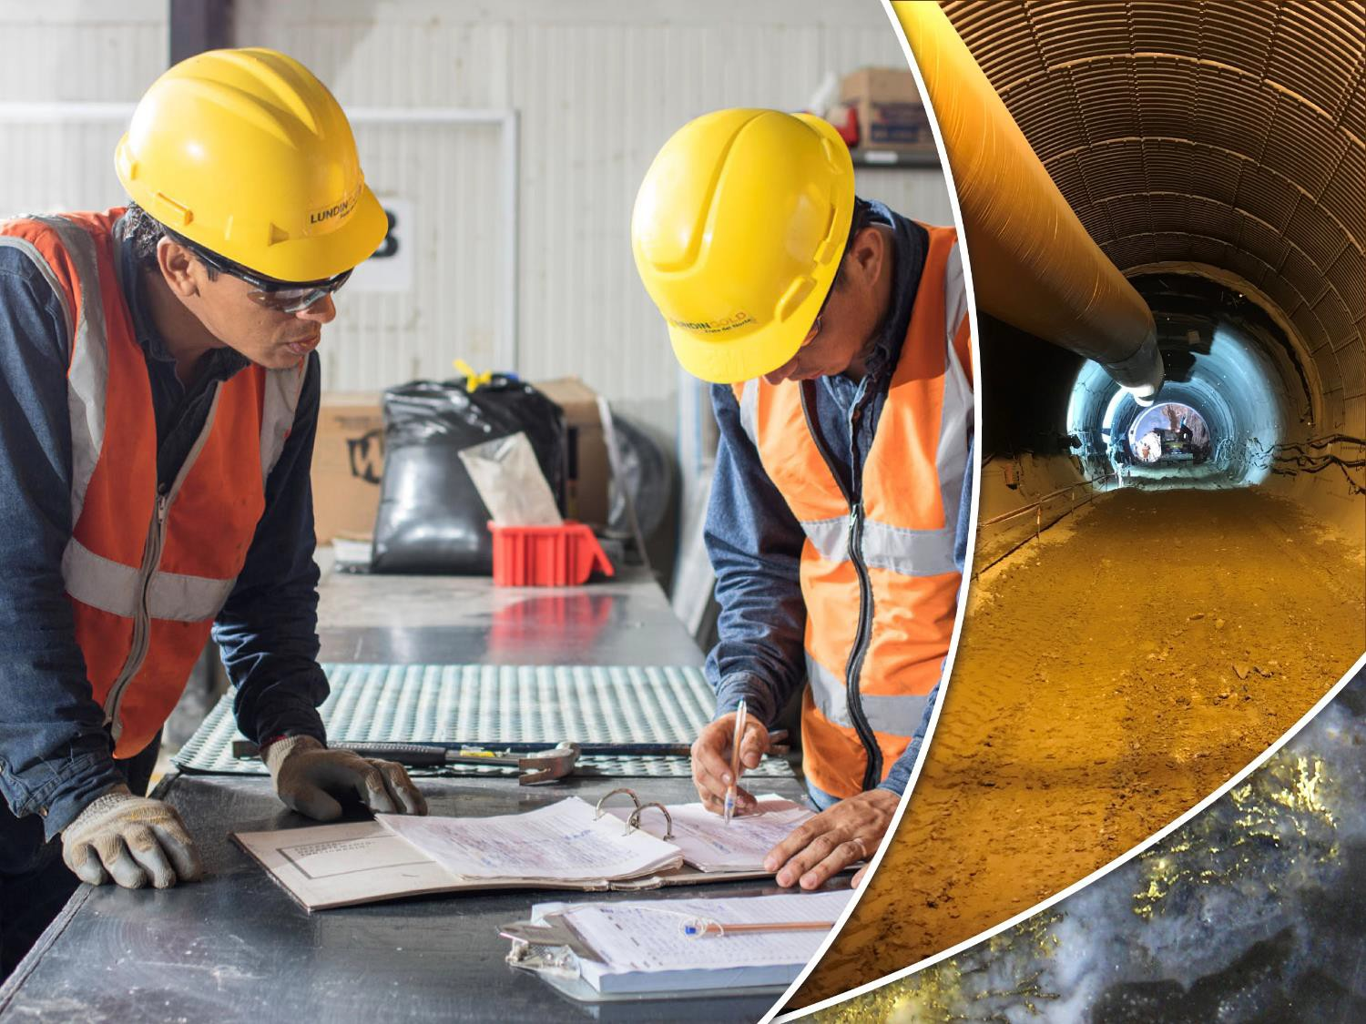
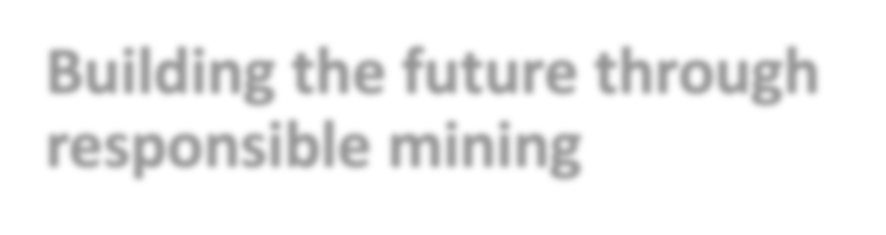
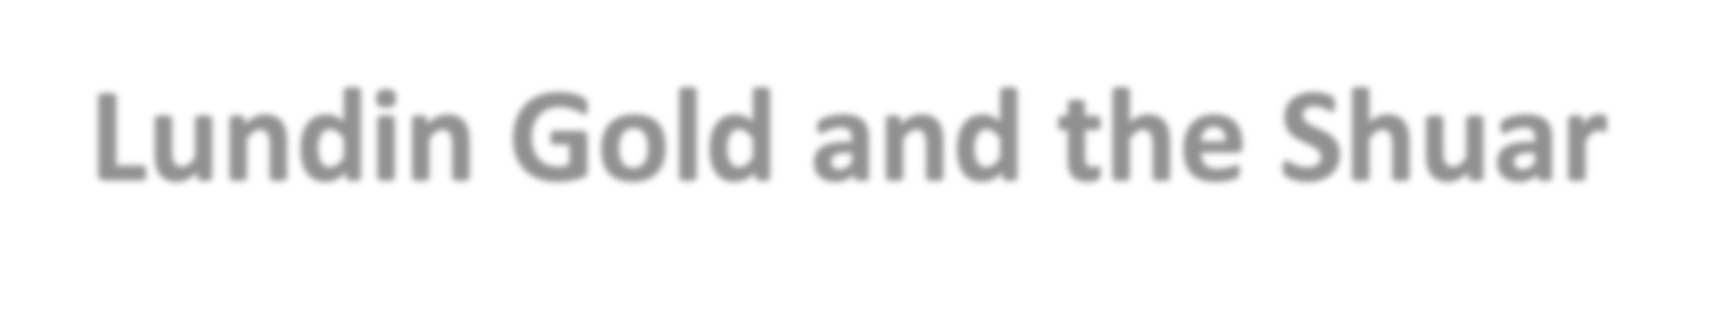


Building the future through responsible mining
Lundin Gold and the Shuar Federation of Zamora Chinchipe
March 2019

Slide 7
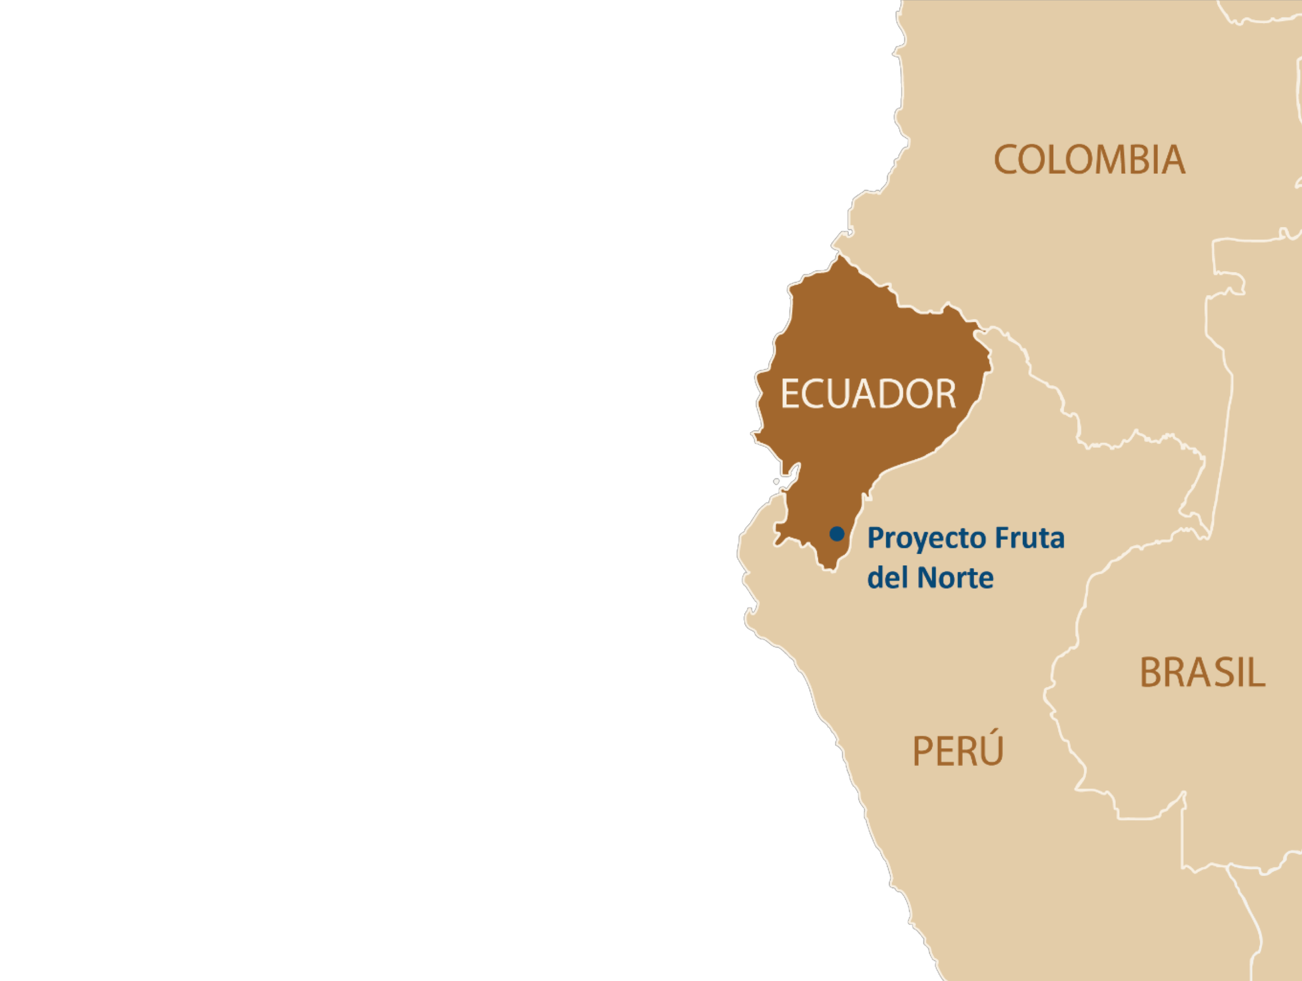
ECUADOR:
Mining can drive sustainable economic growth
Fruta del Norte, categorized as one of Ecuador's strategic projects
Approximate reserves: 4.9 million ounces of gold
Average annual production: 300,000 ounces
Useful life: Approximately 15 years

Slide 8
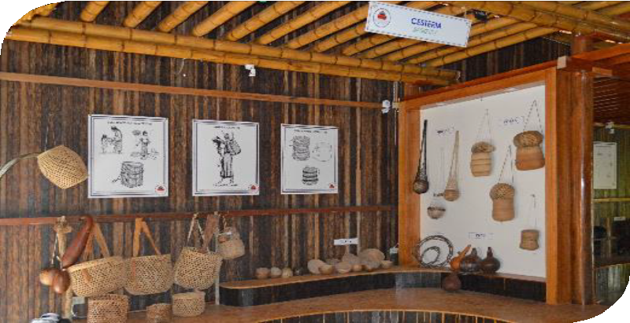

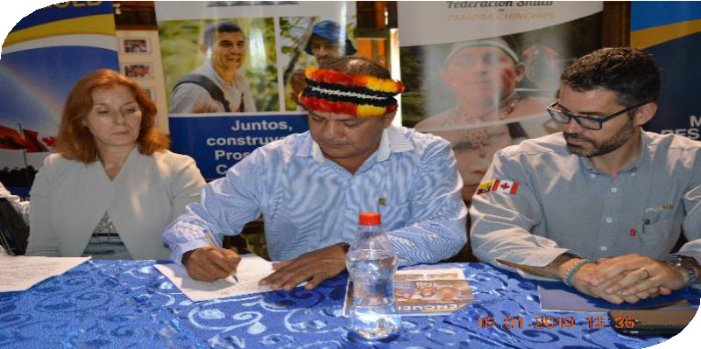

Engagement with the Shuar People is a Priority for Lundin Gold
RECENT MILESTONES
2017
Finalization of an updated framework agreement to ensure ongoing respectful engagement.
Reassessment of mutually- identified priorities.
2018
Implementation of key projects
  Training
  Shuar cultural center
inauguration and establishment of a cultural center consortium
  Agriculture

Slide 9
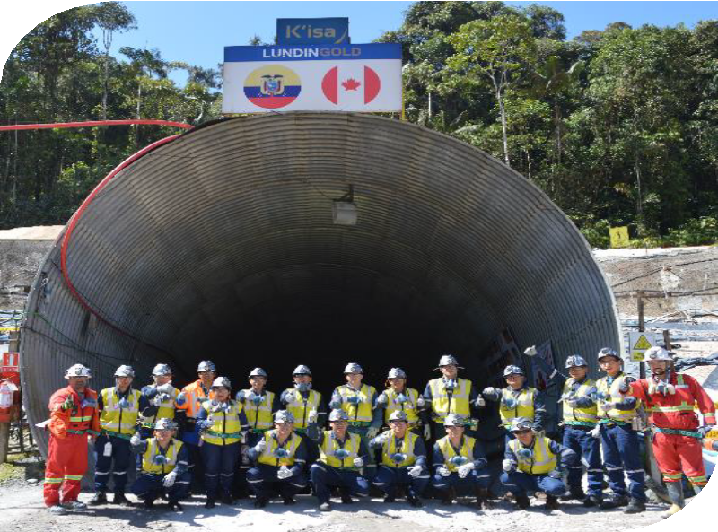
Projects
Mining Operations Training Program
Invitation open to all members of the Shuar Federation who are high school graduates and residents of Zamora Chinchipe.
Prioritization of this community.
To date, 70 community members have taken the Dover test.
Eight percent of the participants are members of the Shuar nation (out of a total of 222 between the 2 cohorts).
EDUCATION
Limitations Identified:
Numerous high school graduates from the community have left the country.
Lack of financial resources for education.
Challenge:
- To demonstrate that access to education means greater opportunities.

Slide 10
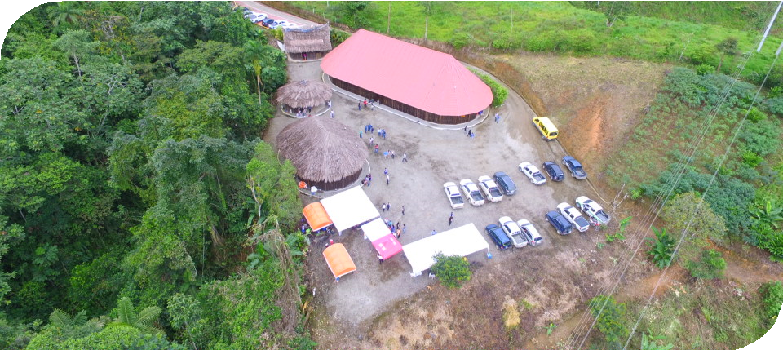
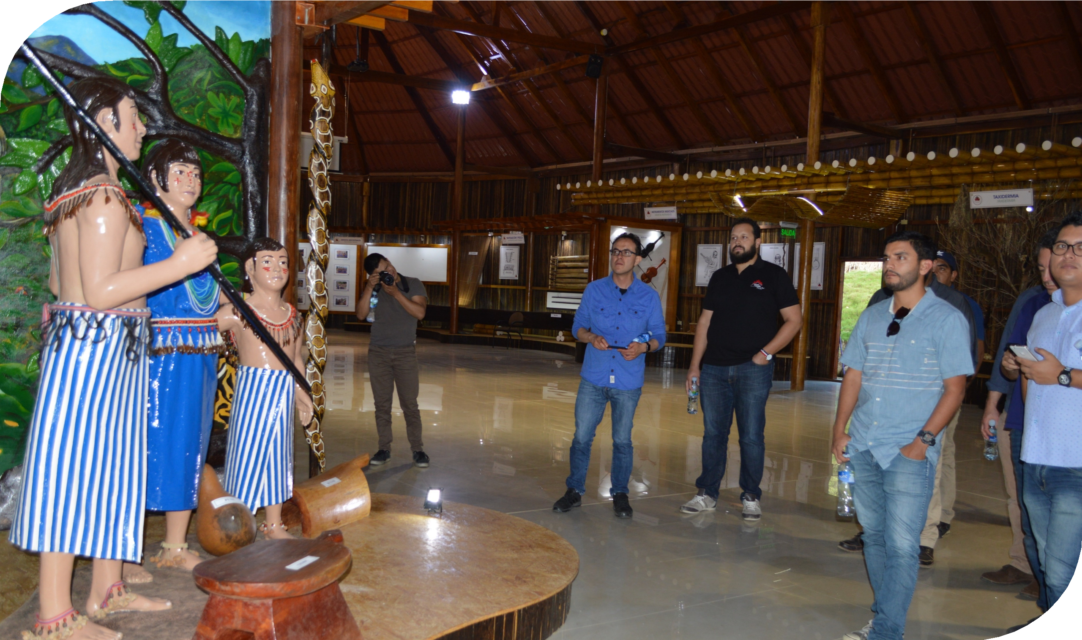
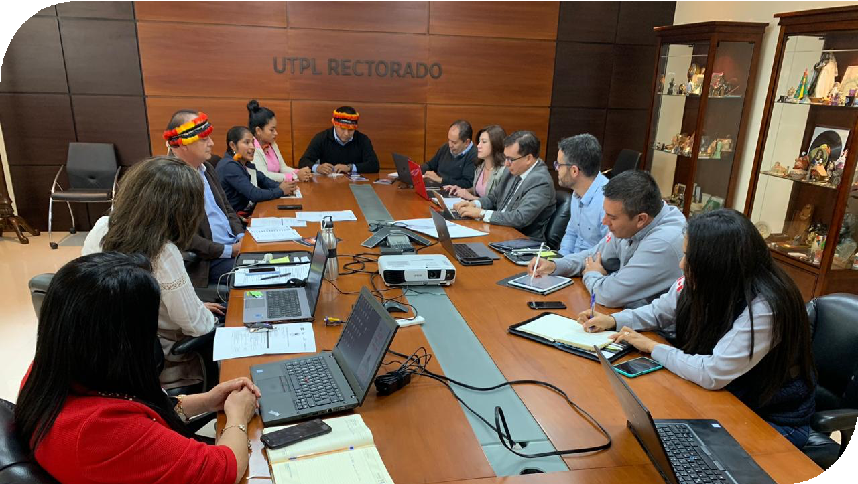
Projects
Shuar Cultural Interpretation Center
Investment in construction and equipment.
Is located in ancestral indigenous territory and was built on Shuar communal lands.
Seeks to conserve Shuar culture through:
Business ventures
Research
Capacity building
Museum
4. Creation of a Cultural Tourism Consortium including several stakeholders having a vision to create a Shuar company.
CULTURE
Challenge:
To ensure the sustainability of cultural strengthening projects in a province where the tourism industry has yet to be developed.
Capacity building and a sustainable vision that considers the current reality facing Shuar communities.

Slide 11
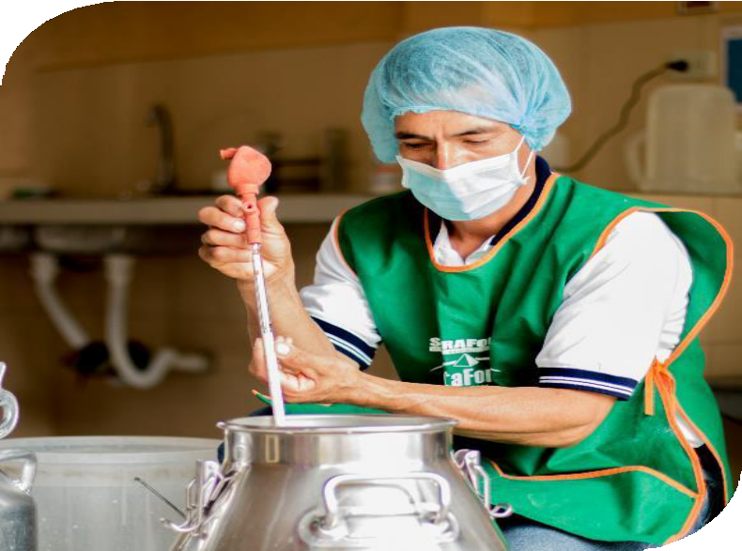
Projects
ECOLAC (Kunki Community)
1. Replicate a successful local project in a Shuar community.
Strengthen the dairy production chain.
Technological innovations and strategies aimed at increasing the quantity and quality of milk and meat products.
Financing through the Ecuadorian Development Bank (BanEcuador).
Around 122 head of cattle will be raised among 18 Shuar families.
LIVESTOCK
Identified limitations:
- Common borrowing practices.
Challenge:
- To obtain other forms of financing with the assistance of partners like Ecolac, the Lundin Foundation, and Lundin Gold.

Slide 12
Contact information:
Nathan Monash
Vice President, Business Sustainability nathan.monash@lundingold.com www.lundingold.com
@LundinGoldEC / LundinGold Lundin Gold
Lundin Gold
Lundin Gold Ecuador

